Slide 1


Kampa Bhai Vocational Training Institute Limited
Company Profile
SKILL DEVELOPMENT AND SERVICE PROVIDER AGENCY
Under Ministry of Skill Development & Entrepreneurship, Govt. of India
At – Sai Mandir Lane, Rugudipara, Balangir
PO- Balangir, Dist – Balangir, Odisha, India
Email – kampabhaigroupsbgr@gmail.com
Website – www.kbvtiindia.org

Slide 2

About Us:
Kampa Bhai Vocational Training Institute Limited is a client centric company, we take pride in our ability to provide quality services - whether they are a Corporate house or a Government organisation. We are a multi-skilled, multi-disciplined firm, offering clients a wide range of industry-focused solutions. Kampa Bhai Vocational Training Institute Limited, established on 16th April 2008 as Kampa Bhai Vocational Training Institute, which is now converted into a Public Limited Company on 20th August 2015. Now it is a booming Skill Development & Service Provider Agency (AN ISO Certified 9001:2008 PUBLIC LIMITED COMPANY) & also a Vocational Training Provider under Directorate General of Employment & Training, Ministry of Labor & Employment Govt. of India, SPIU, Directorate of Technical Education and Training, Govt. of Odisha and Accredited Training Center for EDP Under PMEGP, KVIC, Ministry Of Micro, Small & Medium Enterprises, Govt. Of India, Directorate of Industry, Ministry of Skill Development & Entrepreneurship, Govt. of India, National Skill Development Corporation (NSDC) and Sector Skill Council (SSC), Ministry of Finance, Govt. of India, National Digital Literacy Mission(NDLM) under Ministry of Communications and Information Technology Govt. of India & Department of Electronics and Information Technology and successfully continuing the project National Urban Livelihood Mission (NULM) under Ministry of Housing & Urban Poverty Alleviation, Government of India in different district of the state Odisha and also Odisha Urban Livelihood Mission(OULM) under Ministry of Housing and Urban Development Department , Govt. of Odisha. Also we had recently tied up for projects with Govt. of Jharkhand, Govt. of West Bengal and different Ministry of State and Central Govt.
We are mainly into following:
Skill Development
Consultancy Services
Service Provider
Out Sourcing & Software Development etc.

Slide 3

Legal Status
The Organization Regd. Under Govt. of India, Ministry of Corporate affairs, Registrar of Companies, Cuttack, 3rd Floor, Corporate Bhawan, Plot No. 9(P), Sector: I, CDA
Registration Number - 211.2008 (as KBVTI Partnership firm) / CIN No. - U80220OR2015PLC019306 ) (as KBVTI Ltd Converted into a public limited company
Date of Registration - 16.04.2008 (as KBVTI Partnership firm) / 20.08.2015 (as KBVTI Ltd Converted into a public limited company )

Slide 4

Our Vision
Our institute will be regarded as the center of Skill Development, Vocational and Computer Education, a service provider of choice for career commencement and professional development to the society. We will be committed to gain a reputation of excellence in delivering quality education services to, local businesses, domestic and national students enabling all stakeholders to reach and achieve their goals.
To develop learning, governance and empowerment systems which are world-class and value-based and which are responsive to the individual and social developmental needs of the people by bridging the Digital Divide.

Slide 5

Our Mission
To advance vocational education and training to develop professional competencies for the future workforce and foster social and economic development of local and international communities
“Impact Training Institute endeavors to be a professional, community spirited and progressive training body, offering flexible, tailored training and education solutions designed to educate, inspire and motivate individuals and businesses helping you reach and achieve your goals and aspirations”
To offer life-long learning, governance and empowerment services through appropriate partnerships
  • to a very large population with various diversities : Bigger
  • with high quality of relevance and applicability in life and work : Better
  • at an affordable cost : Cheaper
  • within a shortest possible time : Faster
  • with a wide accessibility from metros to villages: Wider
  • in a mass-personalized manner: Deeper personal experience

Slide 6

Goals
To prepare the people for knowledge-based economy and society
  • To champion the cause of life-long learning with developmental orientation
  • To stimulate the creation of word-class knowledge resources
  • To provide universal access to them through Information Technology
  • To bridge the Digital Divide and resultant Knowledge Divide

Slide 7
OBJECTIVES
To ensure that every student is given opportunity to develop his/her potential without regard to race, color, creed, national origin, gender, sexual orientation, economic status or disability.
To provide opportunities for students to acquire contemporary workplace skills such as communicating, organizing and analyzing information, solving problems, using technology, initiating and completing assignments, acting ethically and professionally, interacting with others, understanding the structure and dynamics of organizations, and taking responsibility for career and life choices.
To provide counseling and assistance to students concerning social issues, employment and educational opportunities, and vocational orientation.
To provide programs and activities which contribute to health and well-being, a safe environment, a sense of belonging, and respect for self and others.
To use student assessment results to review and improve curricula, courses, programs, and instructional practices.
To encourage students to pursue professional improvement leading to certification/licensure in their trade areas and post secondary education.
To provide continuing adult education with a focus on developing technical skills.
To provide personnel with the resources and the support needed to grow and develop professionally toward a goal of raising student achievement.
To promote cultural understanding within a diverse population.
To develop partnerships with business, industry, government, and the community.

Slide 8

Our Services:-
Skill Development & Placement
Computer Education (Software/ Hardware)
General Education
Distance Education
Online Education
Self-Help Group Developed through under Govt. Programme
Health Programme
Environmental Programme
Sports Art & Culture Programme
Marketing Consultancy
Service Provider Agency
Software Development

Slide 9
Tie ups & collaboration:-
VTP Under DGE&T, Ministry of Labour & Employment Govt. of India, SPIU, DTE&T, Govt. of Odisha.
Accredited Training Centre for EDP under PMEGP, KVIC & KVIB under Ministry of MSME, Govt. of India and Directorate of Industry, Ministry of Skill Development & Entrepreneurship, Govt. of India.
Alliances with leading university like NIOS, IGNOU and Sambalpur University.
District Planning Office
District Chamber of Commerce
National Skill Development Corporation (NSDC) and Sector Skill Council (SSC), Ministry of Skill Development & Entrepreneurship, Govt. of India
NDLM under Ministry of Communications and Information Technology Govt. of India and Dept. of Electronics and IT.
National Urban Livelihood Mission (NULM) under Ministry of Housing & Urban Poverty Alleviation, Govt. of India in different district of Odisha and also Odisha Urban Livelihood Mission (OULM) under Ministry of Housing & Urban development dept. Govt. of Odisha. And recently we had tied up with Govt. of Jharkhand, Govt. of West Bengal and Different Ministry of State and Central Govt. for different Projects.

Slide 10




















Our Association:
We are associated with:
PMKVY
NIEBUD
MANAS
DDUGKY
NULM
OULM
NSDC
NDLM
NCVT (SDI-MES)
MSME (PMEGP)
KVIC
KVIB
DIC
NEILIT
ESDM
We are also working with following :
TCS
SIFY Technology
TIMESPRO

Slide 11



Skill Development Trainings:
Pradhan Mantri Kaushal Vikash Yojana (PMKVY):
Various Skill sector courses
run and managed by NSDC and sector skill councils
National Digital Literacy Mission (NDLM):
Basic computer literacy
NIESBUD:
EDP
ESDP
PMUMY
MANAS & DDUGKY:
Various Skill development courses
MANAS comes under Ministry of Minority Affairs
DDUGKY comes under Ministry of Rural development
EDP under PMEGP , KVIC (MSME)
EDP
ESDP

Slide 12


Skill Development Trainings:
National Urban Livelihood Mission (NULM):
Various Skill sector courses
run and managed by Ministry of Housing & Urban Alleviation,
Govt. of India.
Odisha Urban Livelihood Mission (OULM):
Various Skill sector courses
run and managed by Ministry of Housing & Urban Alleviation,
Govt. of India.
NCVT - SDI:
Various Skill sector courses
Sambalpur University Courses Under DDCE:
MCA, MBA, BBA, BCA, PGDCA etc.
National Institute of Open Schooling (NIOS):
10th and +2 Course

Slide 13

Projects executed:
NCVT- MES:
2500+ Trainee Trained in Different Courses
NSDC- STAR:
1000+ Trainee Trained in Different Courses
NULM:
3000+ Trainee Trained in Different Trades
OULM:
1000+ Trainee Trained in Different Trades
NDLM:
500+ Trainee Trained and Continue
KBVTI Self Financing Courses:
5000+ candidates trained
MANAS & DDUGKY, NIESBUD & NULM :
In progress

Slide 14



Management Team:
Management Team: professionals with work experience in reputed corporate houses, people with political background and retired bureaucrats.
  Professionals from corporate world
  People with political Background
  Retired Govt. officers
  Subject matter experts
Our professional team help our clients achieve their goal with ease.

Slide 15
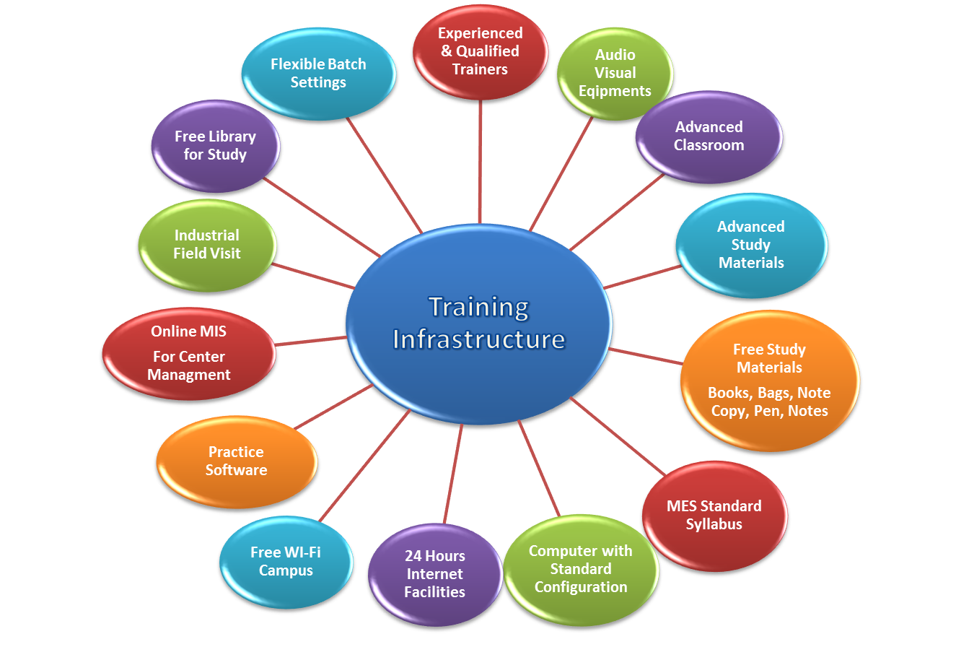
Training Infrastructure:

Slide 16
Benefit of Becoming a KBVTI Authorized Training Partner
Authority to use BRAND KBVTI in your promotional activities.
Franchise at low cost with flexible terms and conditions.
Join a well developed network and reap the benefits of becoming a partner in the network.
Get structured courses designed by a team of experts keeping the market demand in mind.
Placement assistance to all students passing out of KBVTI center.
The students will get a computer diploma which is recognized UGC and DEC approved University, NCVT & NSDC etc.
Specially designed unique course material in Hindi, English & Regional Language.
A chance to participate in various events conducted by KBVTI such as Scholarship exams, career fair, etc.
Faculty training programs and seminars Support from head office in procuring branded/ second hand hardware at low cost.
Continuous support and advice from experts relating to good marketing and management techniques.
Eligibility for participation in various Govt. tenders relating to Skill Development & Out Sourcing.

Slide 17
Benefit of Becoming a KBVTI Authorized Training Partner
Assistance in printing promotional materials like banners, bags, posters, etc.
Chance to earn extra income through referring new franchisees.
24x7 real time support from head office.
Consultancy, advice and support to transform an average computer center to a center of excellence.
Identity card to each center head and to all the students from head office.
Conduction of examinations in controlled environment in tune with university norms.
If the franchisee taken with all this three courses (DCA, ADCA and PGDCA), you will also be eligible to run university approved KBVTI courses. The affiliation of this courses will be given free*
Steering committee of KBVTI is responsible for giving study center. The committee consists of four members from various depts... On receipt of application, the steering committee comes into action. After the set establishment criteria are met, inspection is conducted before issuing the authorization letter from the head office.
Projects work under different Ministry of Govt. of India & State Govt.
National & State Level Certification (NCVT, NSDC, MSME & many more.)

Slide 18
Online Software & Website Support with the following features:-
Inquiry Management
Student Management
Financial Accounting Management
Course Management
Batch Management
Staff Management
Attendance Management
Search Management
Profile Management Reports (Students, Fees, Dues, and Attendance etc.)
SMS Communications (Fees, Vacation & Special Days Reminder)
Assignment, Notes, PPT, PDF, Videos and Audio uploads
Library Management
I card, Hall Tickets, Certificate & Mark Sheet Management
Automatic Notifications & Remainders
Online Result Management
Online Examination
Placement Manager
Front Office Management
Hostel Management
Event Management
Inventory Management
Registration & Admission
Students Fees & Billing
Time Table Management
HR & Payroll Management

Slide 19

Government Tie-ups and benefit through KBVTI Association
  All State & Central Govt. sponsored programme sharing 60%
  All university programme 40%
  All KBVTI courses deposit per student only Rs.500/-(Certification & Mark Sheet)
  Other programme sharing change time to time
  As per Govt. norms Service Tax and TDS shall be applicable
  All the Terms & Conditions shall be applicable as per the Project.

Slide 20

Authorization Certificate Samples:-

Slide 21


Certificate Samples:-

Slide 22


Certificate Samples:-

Slide 23
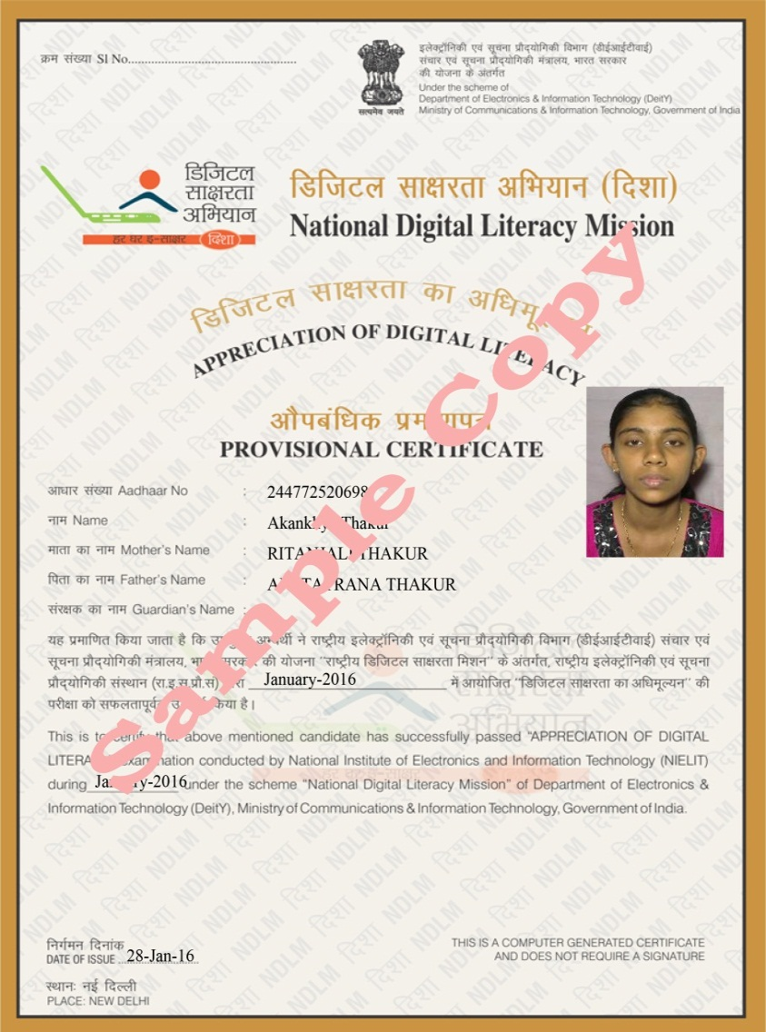
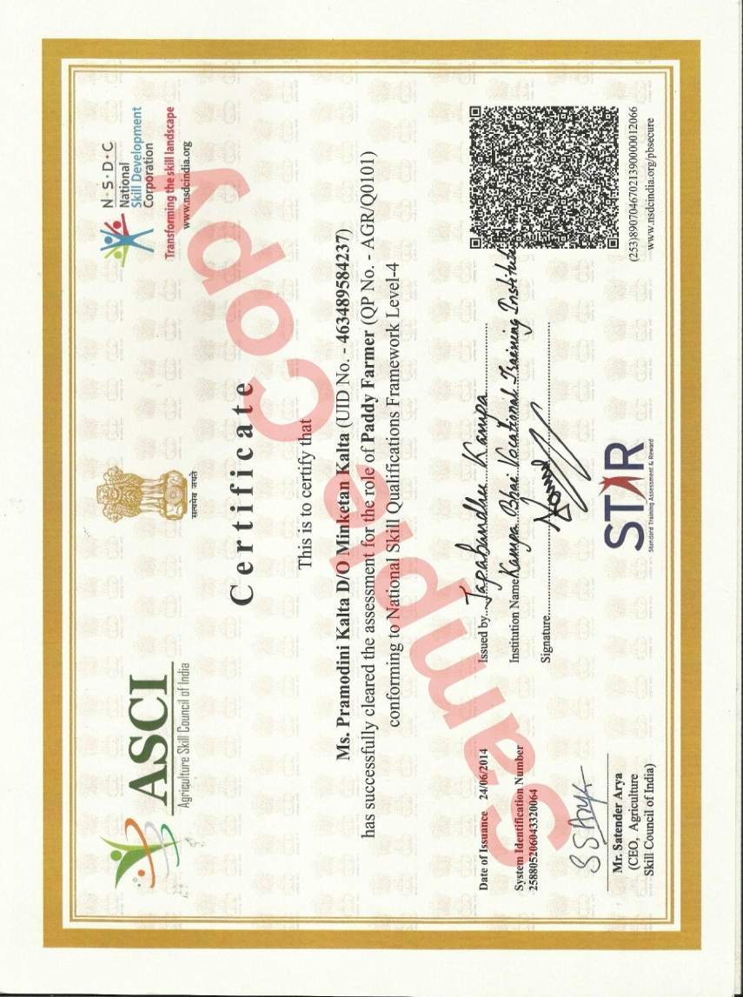
Certificate Samples:-

Slide 24
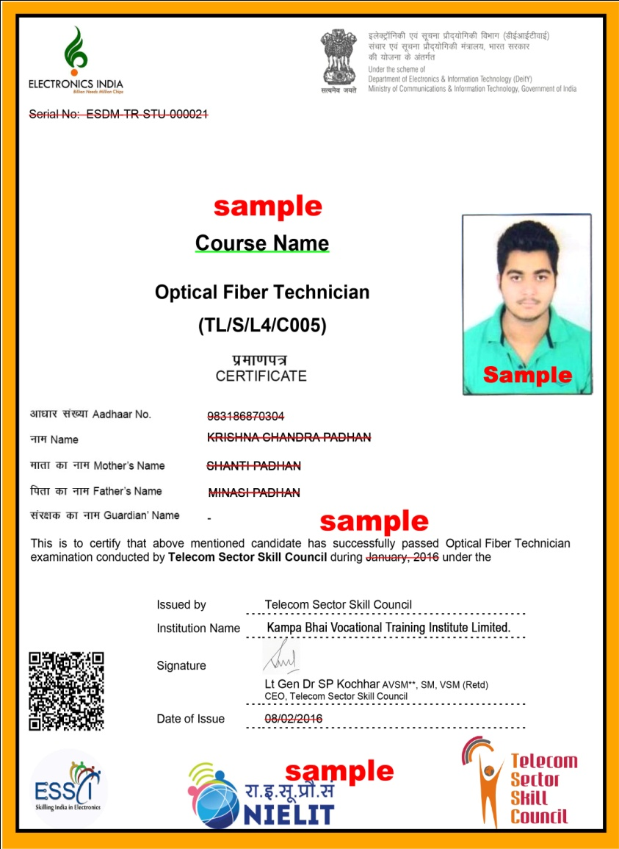
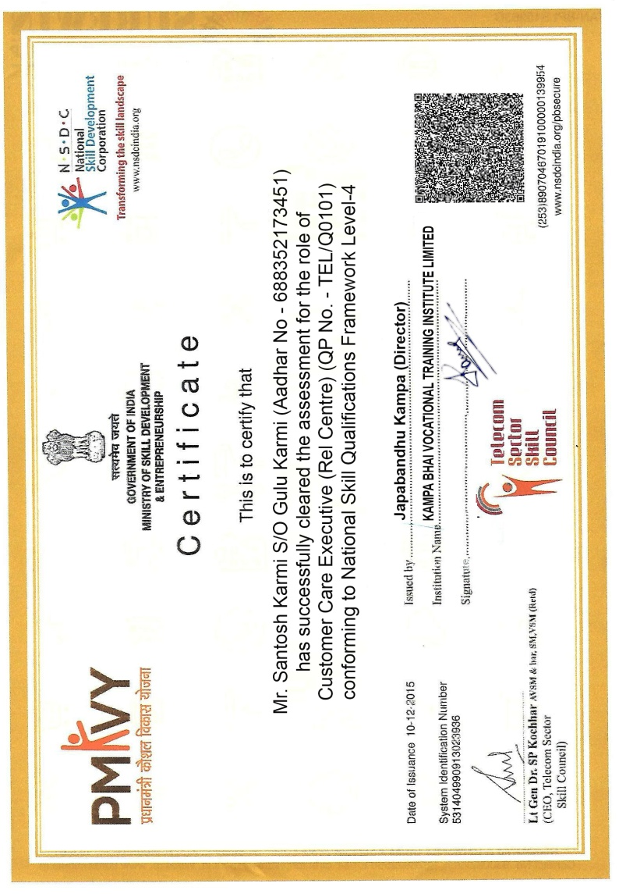
Certificate Samples:-

Slide 25

Our Strength:
  Dedicated and committed Team to work at the grass root level.
  Well organized people’s / Community organizations
  Training center to organize vocational / Skill Development trainings
  Good report with target beneficiaries and local administration

Slide 26
Gratifications:
Keeping in view, the vision, mission, objectives and the goals of our company, we are on progress overcoming all critical situations, all hindrances and all barriers faced on the way.
In this Endeavour, we are much more thankful and convey our hearty gratifications to all our friends, well wishers and benevolent donors who have extended their whole-hearted co-operation and patronizing support for a successful implementation of our program.
After successful establishment of its learning center franchise network in NEPAL & BHUTAN and also plans to appoint franchise network for various other Asian countries and USA, UK, AUSTRALIA & AFRICA etc Franchise inquiry from various countries is solicited

Slide 27
FRANCHISE REQUIREMENT / ELIGIBILITY:
Candidate should be a graduate. The person who wants to take the Franchise center should be educated & able to handle the center effectively.
Infrastructure:-
There should be at least 1000-1500 square feet are for operating a center
Counseling Room
Centre Director Room
Faculty Room
1 Theory Class Room (Minimum)
1 Computer Lab with 10 PC (Minimum)
1 Skill Lab as per the SSC norms
Computer & IT resources :-
There should be at least 10 Computers with latest configuration, Postpaid Telephone connection with Broadband internet connection Printer, scanner
Man Power:-
Center Manager
Counselor
Marketing Executive
Tele Caller
Faculty-as per Course Module
Office Boy

Slide 28
NEW BRANCH OPENING REQUIREMENT / ELIGIBILITY:
Minimum Criteria:-
There should be at least 100 students, where the franchise wants to operate a center
Deposit of Rs. 10,000/- as franchise fees, which is non- refundable.
Required Documents like Resumes and Xerox copy of Educational
Qualifications, Voter ID, Aadhar Card, Passport, Driving License and 4 nos. of color passport size photo of Centre Director and the Man power of the organization. Minimum term of agreement will be 5 years
Every new admission form will have to be deposited at the Head Office within the first week of the month.
All legal expenses and Inspection charges will be bear by the branch office.
N.B:- Cash Payment, Online Payment, Cheque Payment and Demand draft should be in favor of Kampabhai Vocational Training Institute payable at Balangir or Bhubaneswar of Rs. 10,000/- (Payment available in Full or Installment)

Slide 29
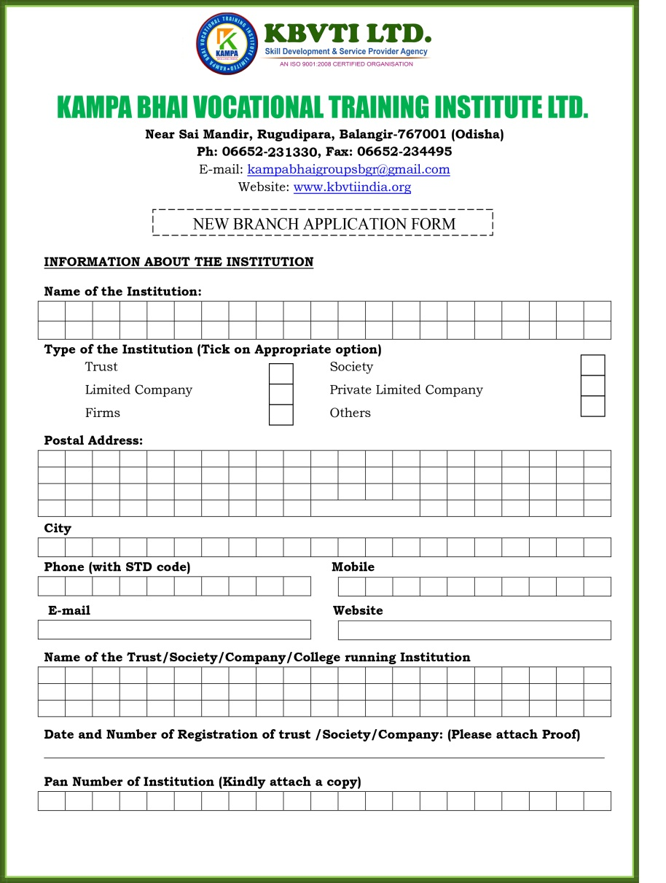
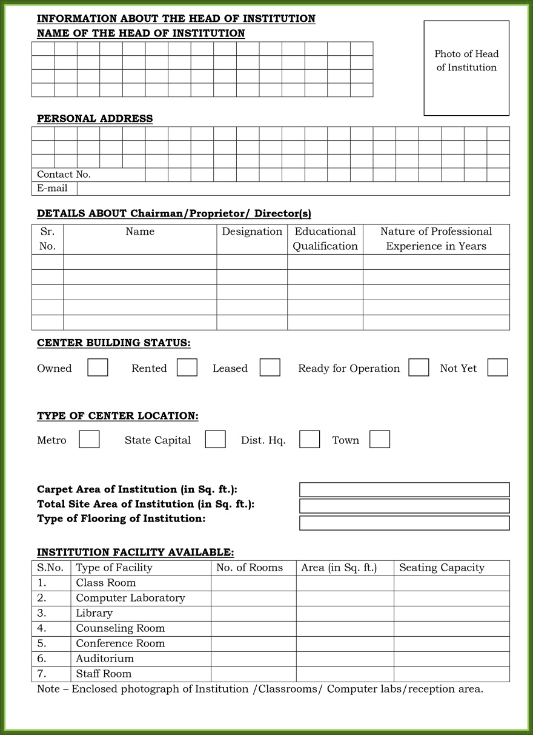
New Branch Opening Application Form:

Slide 30
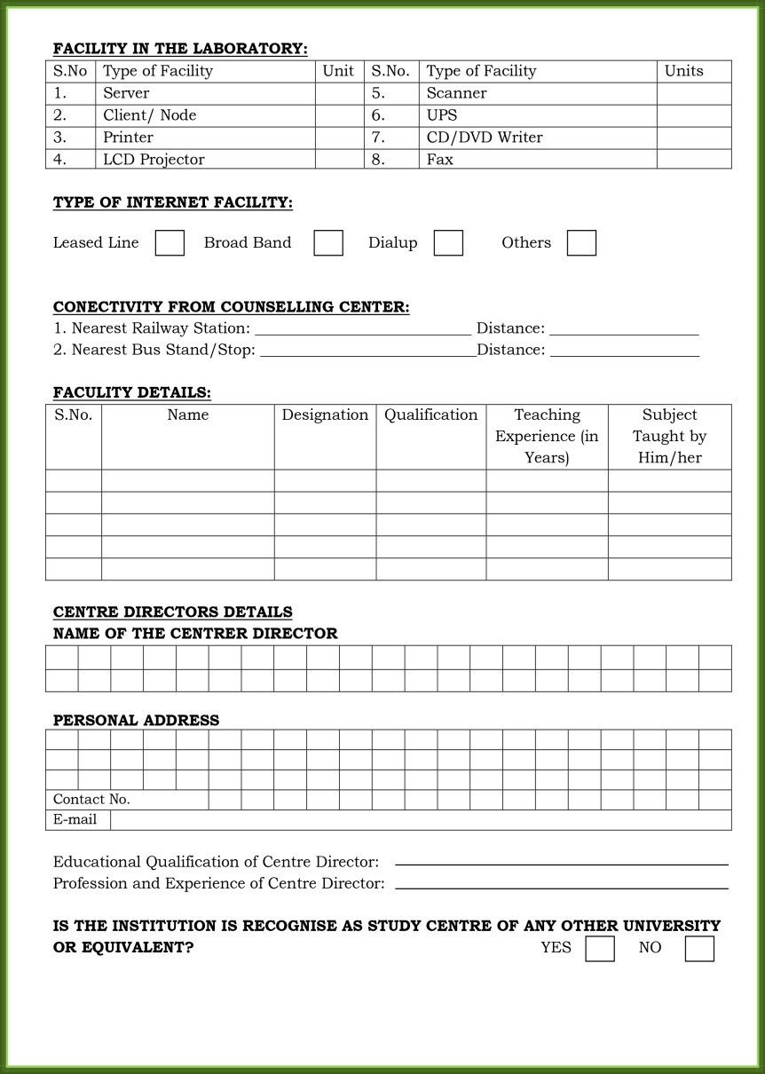

New Branch Opening Application Form:

Slide 31


New Branch Opening Application Form:

Slide 32
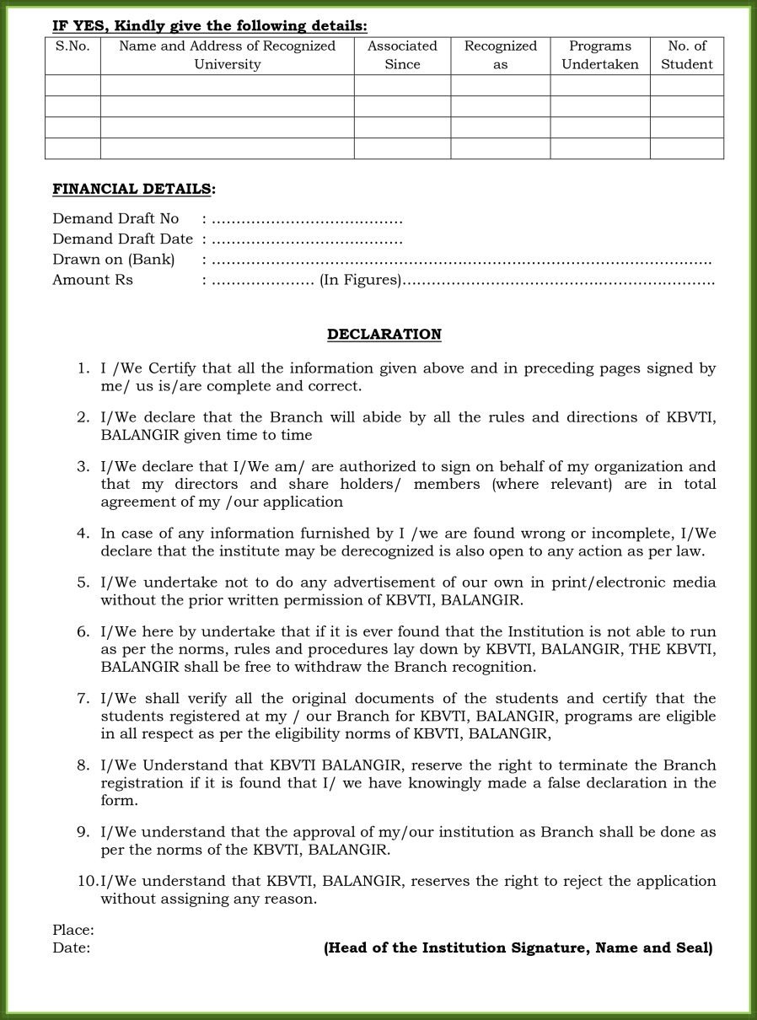
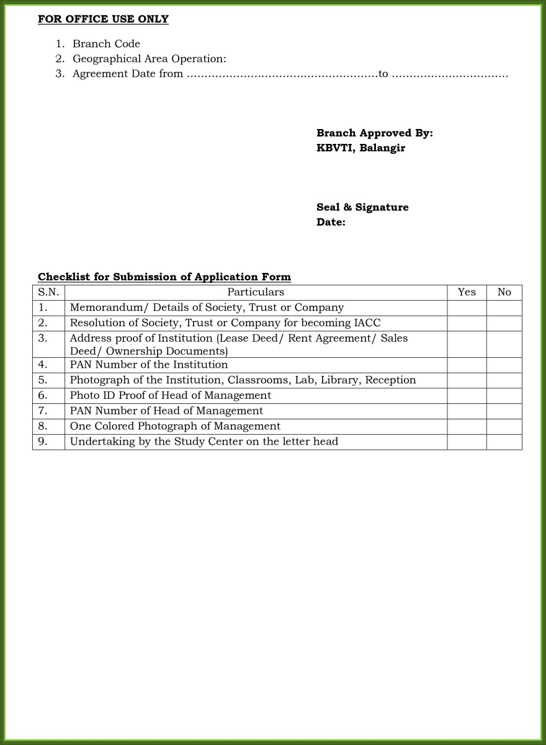
New Branch Opening Application Form:

Slide 33
Thank You

